Slide 1
Churn baby churn
Prediction inferno
Victor Nicolausson

Slide 2
The problem
TelCo is a fictional telecom company based in california, providing internet and phone services.
TelCo has provided us with data from the Q3, and asked us to come up with a reliable method to retain customers.
Data for ~ 7k customers

Slide 3
The Data - customer features
Customer ID
Senior citizenship
Social status
Children / other dependents
Tenure (how long have they been customers)
Phone service (Y/N)
Internet service(Y/N)
Extra online services
Extra support services
Streaming services
Contract form
Billing method
Payment method
Monthly charges
Total charges (lifetime)

Slide 4
Goals
Based on the data provided:
Help TelCo develop a model which helps them predict if a customer is likely to churn
Help TelCo understand which factors are important in a churn event
Suggest possible measures to retain customers

Slide 5
Exploratory data analysis
Off the bat, can we see any patterns at all?

Slide 6
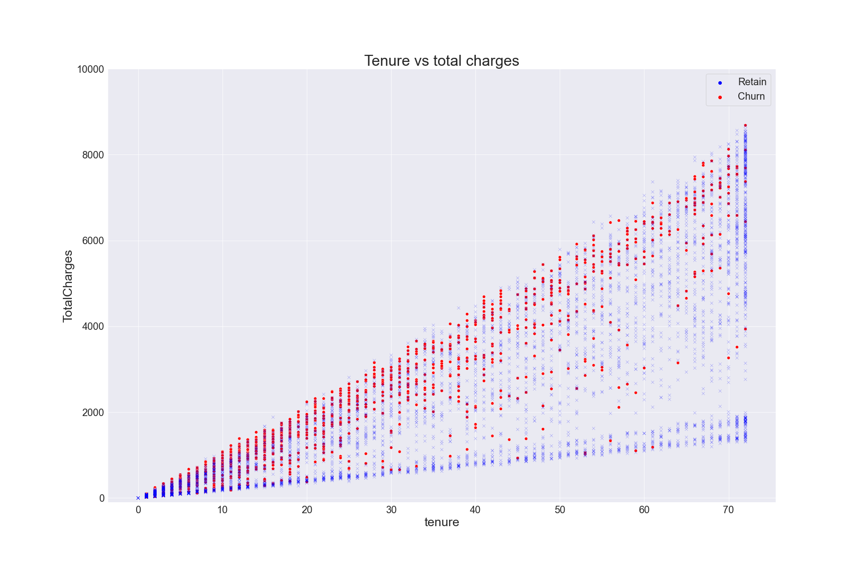
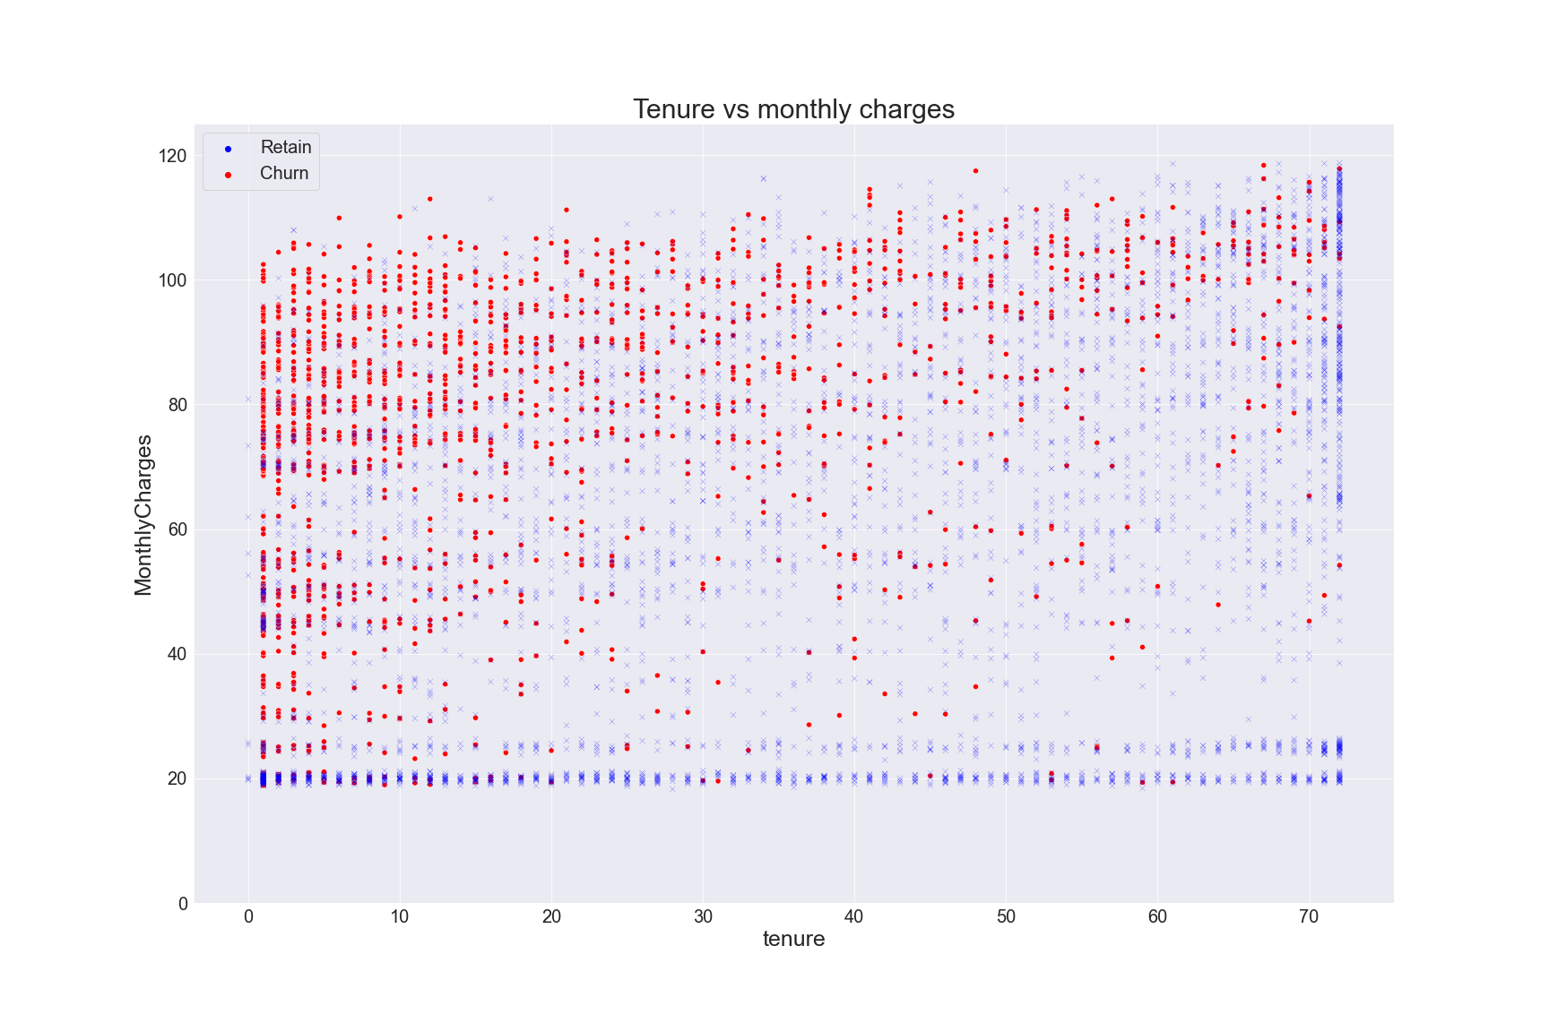
Exploratory data analysis
Continuous features

Slide 7
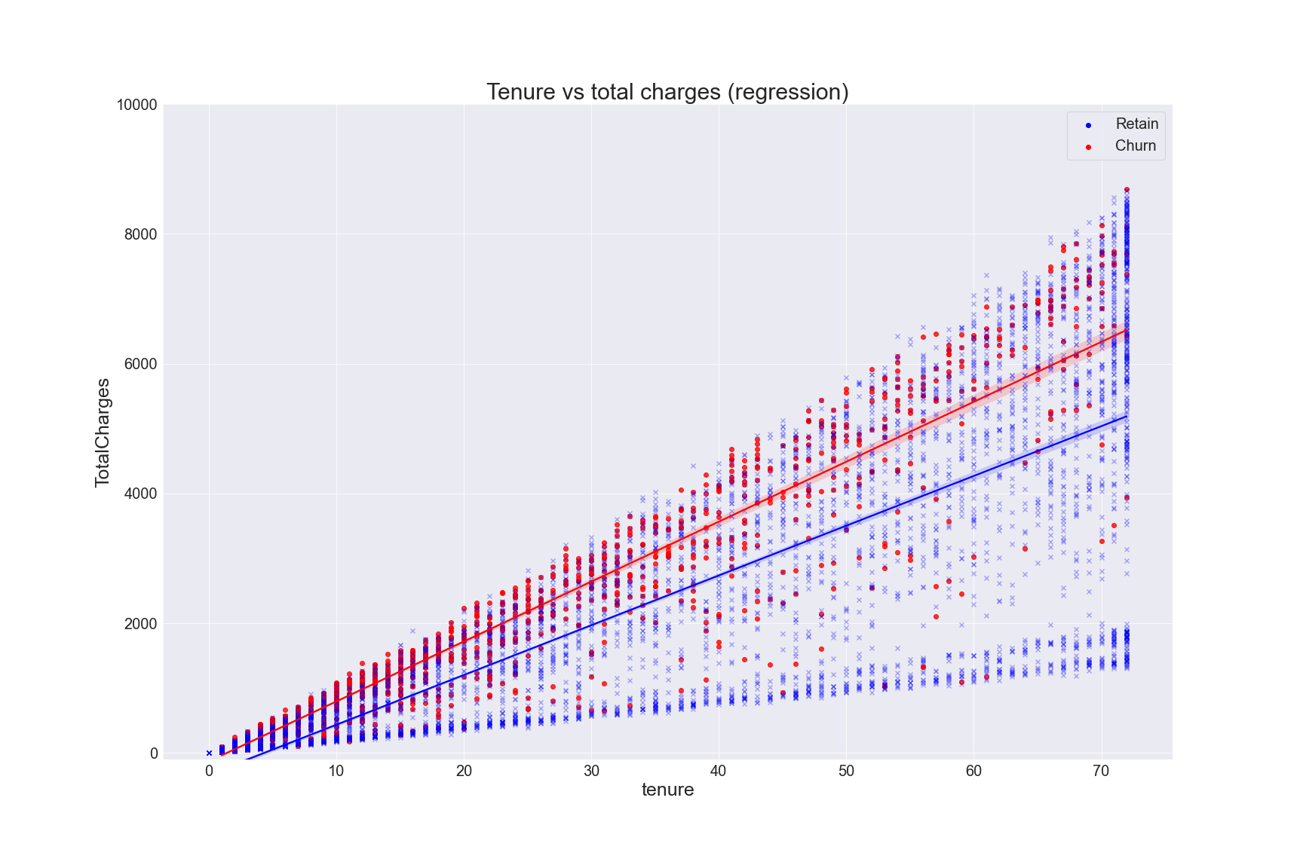
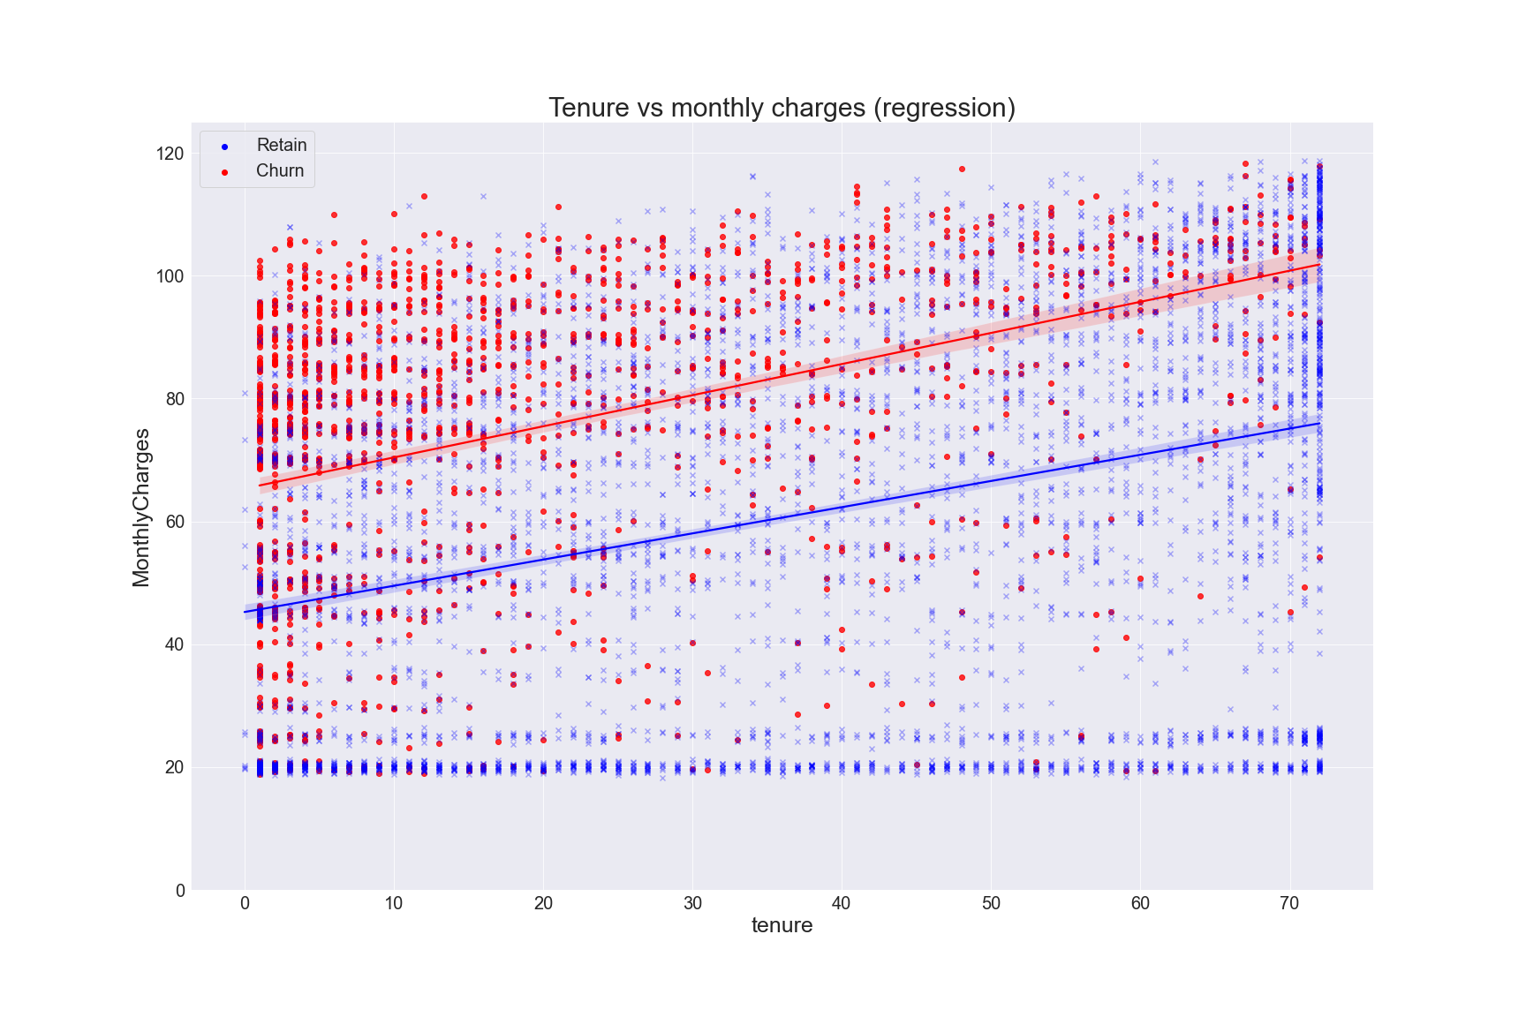
Exploratory data analysis
Continuous features

Slide 8
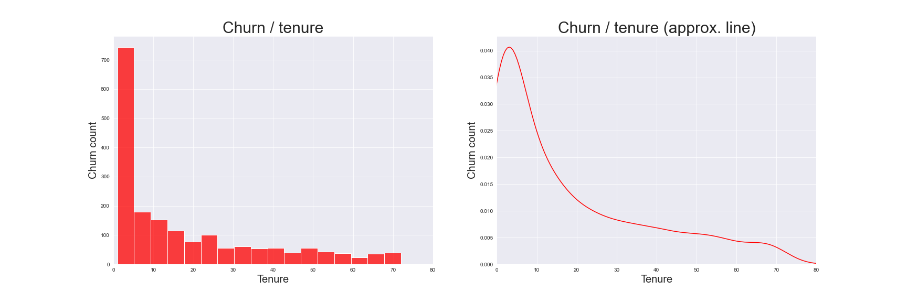
Exploratory data analysis
Churn distribution over time

Slide 9
EDA - Conclusions
When viewed in the context of continuous variables, there seems to be two distinct groups of customers who either churn or retain
The majority of customers who churn tend to do so very early on
What defines customers who churn? Let’s attempt to answer that with clustering.

Slide 10
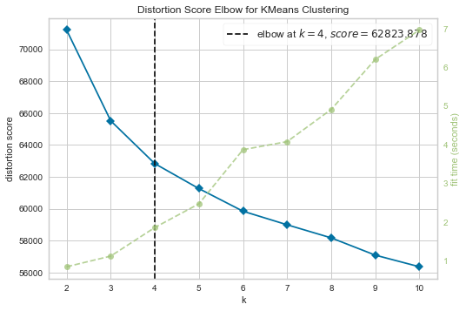
Unsupervised ML
K-Means clustering
Lets see if we can define key properties among churning customers
An initial evaluation shows that we can divide our customers into 4 distinct groups

Slide 11
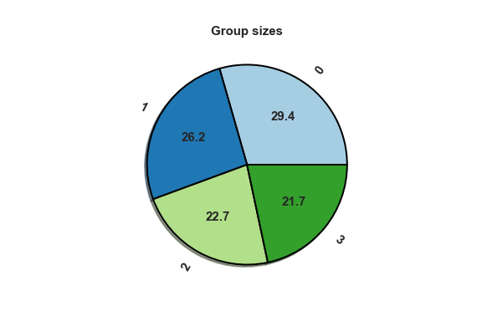
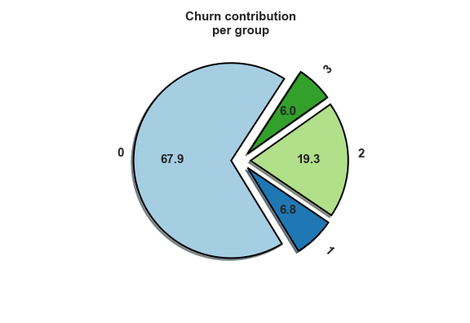
Unsupervised ML
Group characteristics
Our resulting groups are fairly evenly sized
2 groups constitute the majority of churned customers
Groups 0 and 2 will be our main focus moving forward

Slide 12
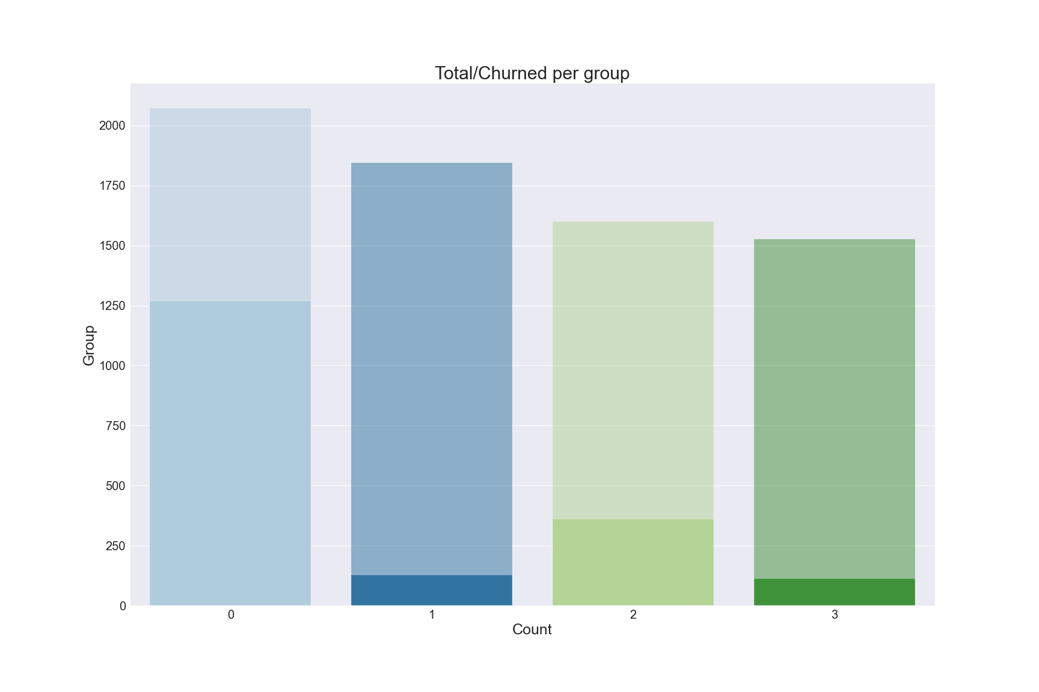
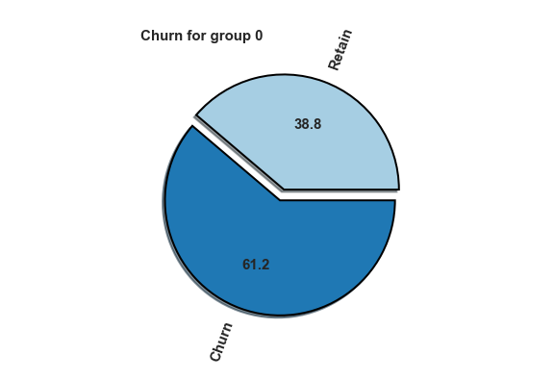
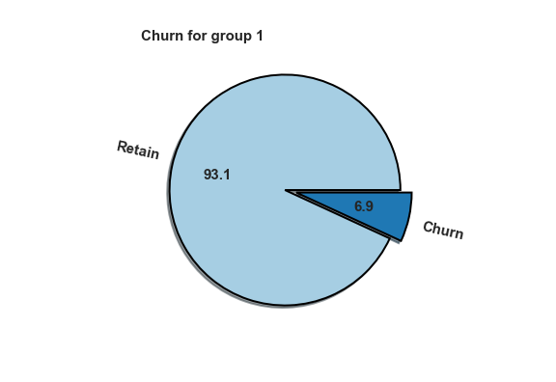
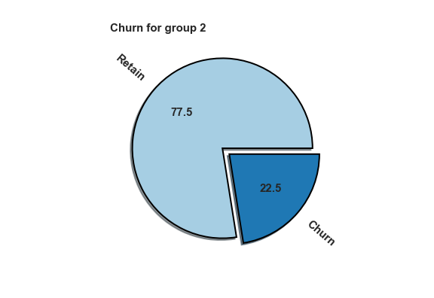

Unsupervised ML
Group characteristics

Slide 13
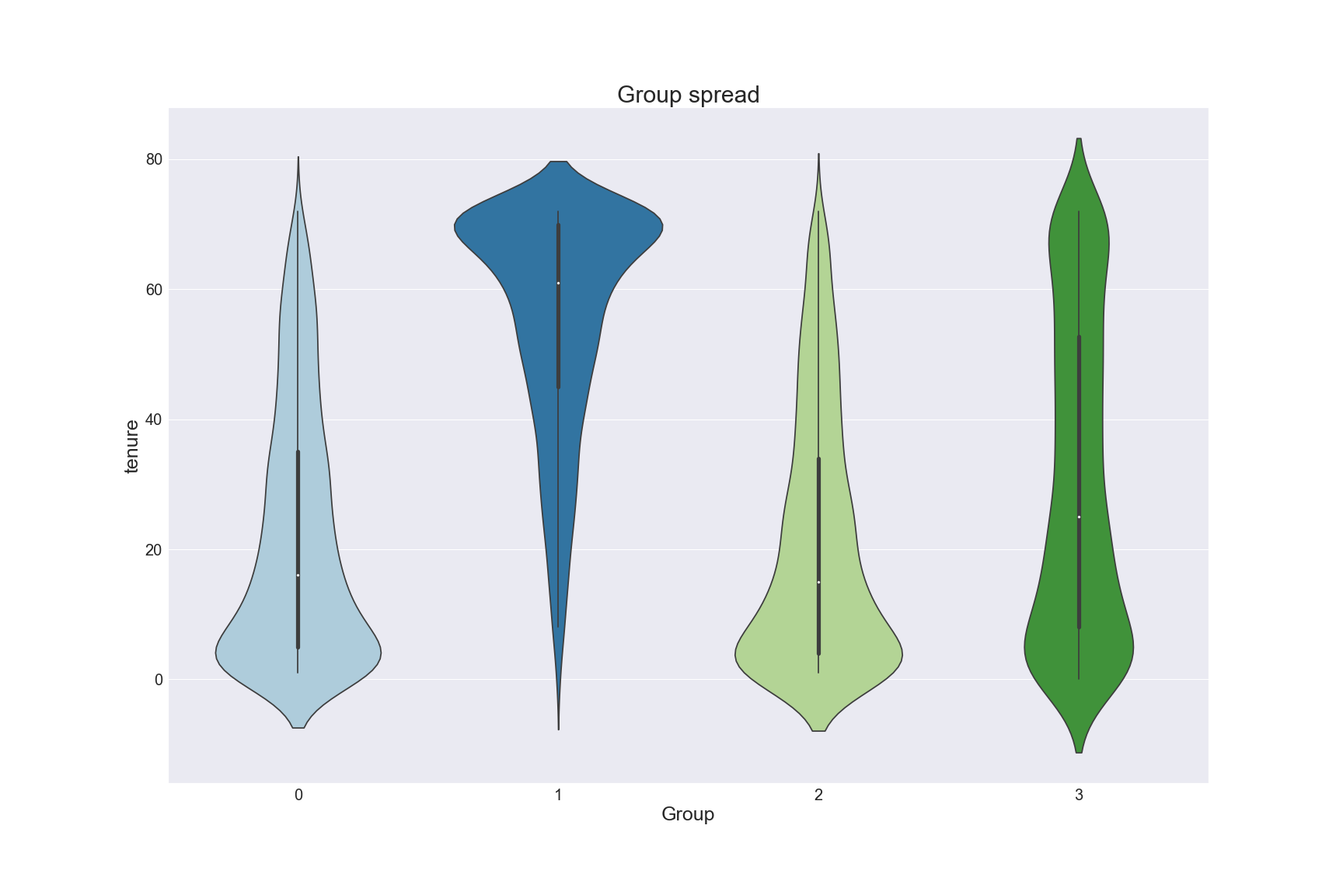
Unsupervised ML
Group characteristics
Both groups have low tenure
Conforms to previous findings

Slide 14
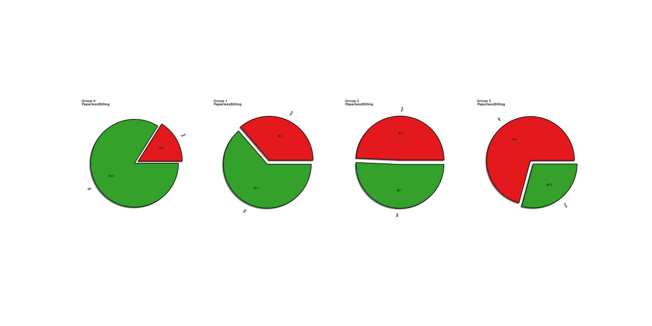
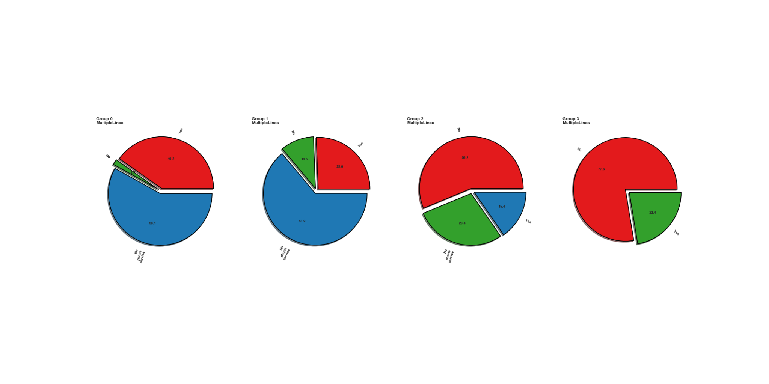
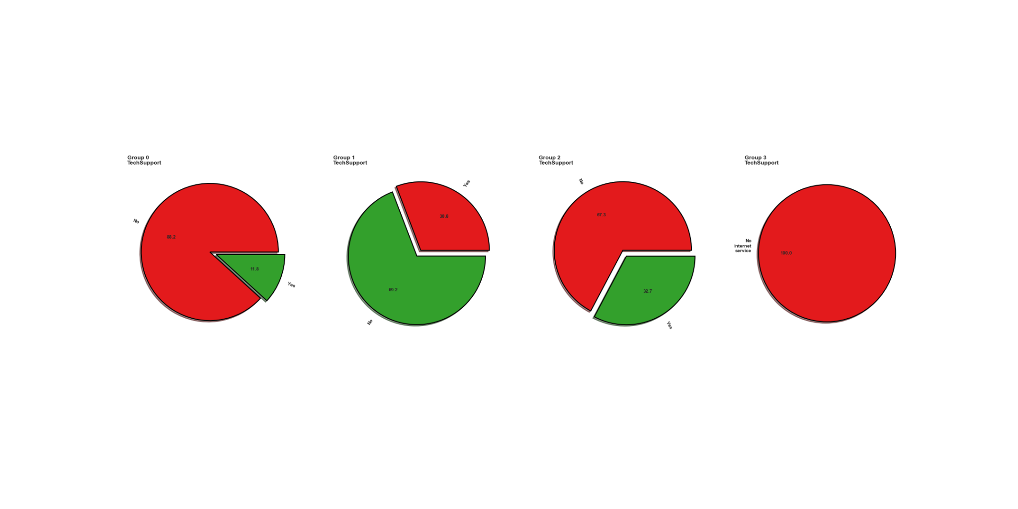
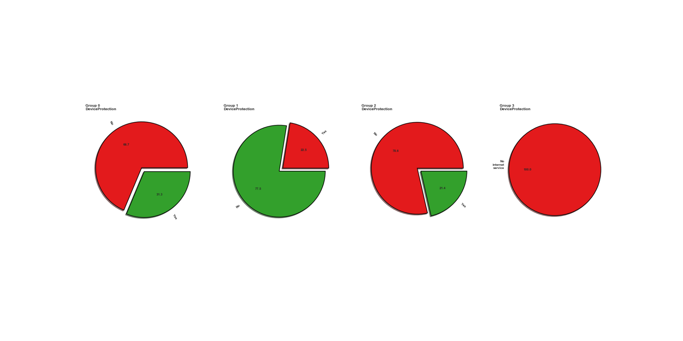
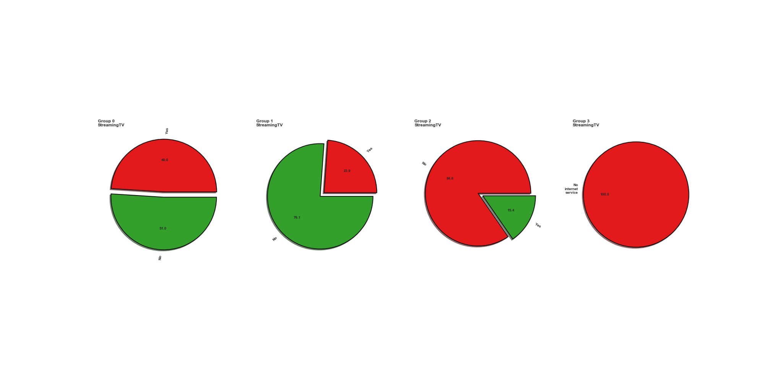

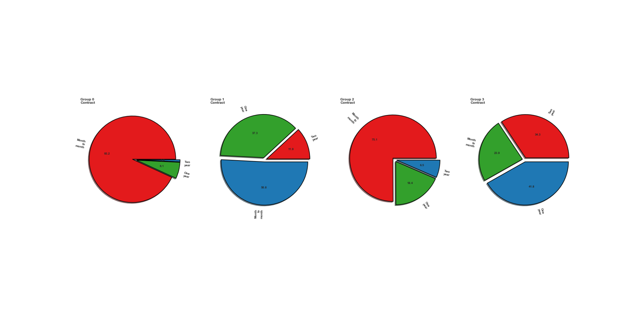
Unsupervised ML
Group characteristics
Additional findings:
Both groups tend to not have partners
Both groups tend to not have dependents
Both groups tend to not have phone service
Both groups tend to have interservice - DSL more popular than fiber optic
Both groups tend to not have extra packages
Streaming services: - Group 0 evenly split, group 2 likely to opt out
Both groups favour M2M contracts - 2 however has ~20% using one year contracts
Group 0 pays online, while group 2 is split 50/50 between paper and electronic payments
Both groups tend to not be senior citizens

Slide 15
Unsupervised ML
Conclusions
Tenure is an important metric
Churning customers usually only have internet
They tend to be single without kids
Contract form is mostly month to month (easy to opt out)
DSL connection is most common, unreliable?

Slide 16
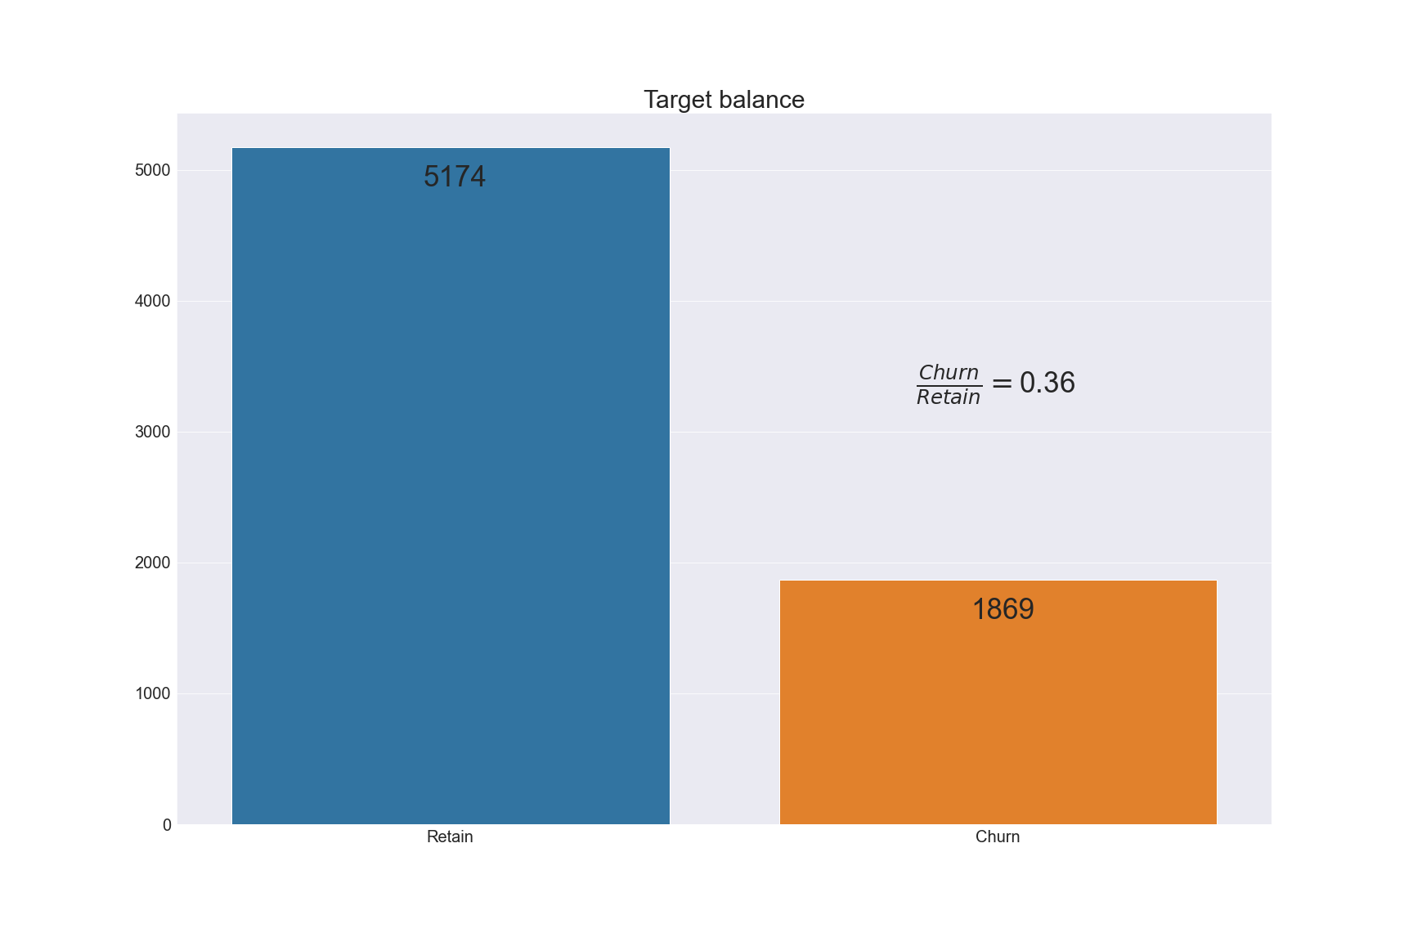
Supervised ML
Classification algorithms
Cross fold validation indicated that a Logistic Regression model was most suited to the task
Let’s see if it’s possible to use this in conjunction with our previous findings in order to automatically predict a churn

Slide 17
Supervised ML - Logistic Regression
Grading performance
We will use recall to grade our models performance during optimization
Recall (catch as many true positives as possible) because: - Most customers who churn do so very early on - Enormous loss of potential LTV - Misgiven incentives (e.g. discounts) are still profitable

Slide 18
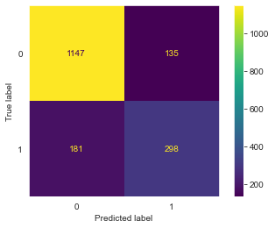
Supervised ML - Logistic Regression
Initial performance
Inital recall score ~0.57
Associated confusion matrix
Not very satisfactory

Slide 19
Supervised ML - Logistic Regression
Improving performance
Feature optimization
Hyperparameter tuning

Slide 20
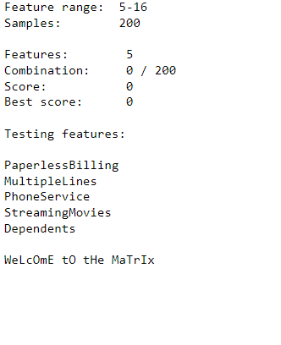
Supervised ML - Logistic Regression
Improving performance
What is feature optimization?
Check random combinations of features
Perform cross fold validation
Calculate recall score for each
Keep best combination
The aim is to reduce number of features required from a customer while also reducing noise and improving model performance

Slide 21
Supervised ML - Logistic Regression
Improving performance
Result, 7 features with a score of ~ 0.66
Contract
StreamingMovies
InternetService
SeniorCitizen
MultipleLines
DeviceProtection
group

Slide 22
Supervised ML - Logistic Regression
Improving performance
We take these 7 features, fit them to our model and perform hyperparameter tuning.

Slide 23
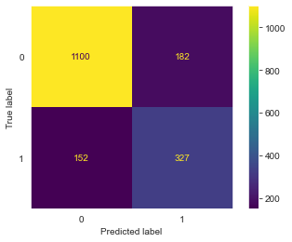
Supervised ML - Logistic Regression
Final result
Recall score increased from 0.57 to 0.68. Increased performance by 19%
We are still missing a few churns though. 152 churned customers were missed in the test data
Model is however a significant improvement when compared to not knowing at all
More data could be gathered for customers, e.g.: - Age - Profession - Location

Slide 24
Conclusions
Our average churner is a young, unmarried, childless male or female, who chooses DSL over fiber optic and does not have phone service with us!
Further increase retainment by addressing crucial factors when a customer signs - Fiber over DSL - Incentivize long term subscriptions - Use marketing to target customers who match our demographics (no kids, singles) - Get them to sign on for a phone as well.

Slide 25
END

